Slide 1

Polymer 3 Workshop
by Gerjohn IJzerman and Richard vd Molen
Leeuwarden, 6 December 2018

Slide 2
What are we going to do?
Introduction
Introduction to Polymer 3
Workshop

Slide 3

Introduction

Slide 4

Why this workshop?
Exploring new languages/features/frameworks etc.
Having fun!!!
But also:
Gathering some insights about how front-end technology lives within Current Accounts
Making people enthusiastic about front-end development
Getting new ideas for future sessions
Hopefully some of you will join us with organizing more of these hackatons/workshops/pizza sessions in 2019.
Please send us your feedback afterwards!!!

Slide 5

What is Polymer?
“The Polymer core provides a thin layer of API on top of web components. It expresses Polymer’s opinion, provides the extra sugaring that all Polymer elements use, and is meant to help make developing web components much easier.”

Slide 6
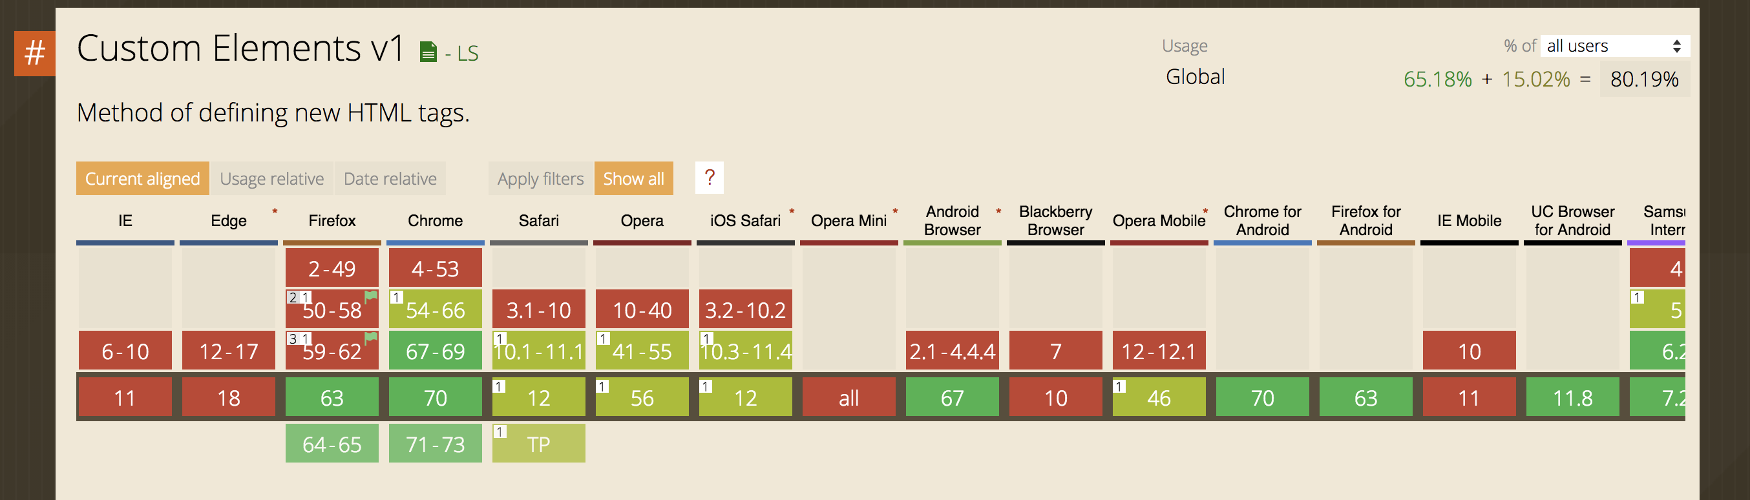
Support in browsers
Source: https://www.caniuse.com

Slide 7
Polymer 3 – Simple Component (MVC)
HTML (View)
Javascript class (Controller)
<!doctype html> <html lang="en"> <h1>Hello World</h1> </html>
import {PolymerElement, html} from '@polymer/polymer/polymer-element.js'; class HelloWorld extends PolymerElement { constructor() {}
} window.customElements.define('hello-world', HelloWorld);

Slide 8
Polymer 3 – Components structure
<!doctype html> <html lang="en"> <app-component>
<sub-component1>
</sub-component3></sub-component3>
</sub-component4></sub-component4>
</sub-component1>
<sub-component2>
</sub-component5></sub-component5>
</sub-component2>
</app-component> </html>
App Component
Sub Component1
Sub Component3
Sub Component4
Sub Component2
Sub Component5

Slide 9
Polymer 3 – Polymer CLI

Slide 10
Polymer 3 - 4 component basics
hello-world.js
import {PolymerElement, html} from '@polymer/polymer/polymer-element.js'; class HelloWorld extends PolymerElement { static get template() { return html` <h1>Hello World!<h1> `; } } window.customElements.define('hello-world', HelloWorld);
Import polymer element
Javascript class + extends PolymerElement
HTML template
Define component

Slide 11
Polymer 3 - How to use a component in HTML?
<!doctype html> <html lang="en"> <head> <meta charset="utf-8"> <title>Polymer Tesla Range Calculator</title> <meta name="description" content="My App description"> <base href="/"> <script type="module" src="src/hello-world.js"></script> </head> <body> <hello-world></hello-world> </body> </html>
Import javascript source
Define component

Slide 12
Polymer 3 - How to use a component in another component?
import {PolymerElement, html} from '@polymer/polymer/polymer-element.js'; import './hello-world.js'; class AppComponent extends PolymerElement { static get template() { return html` <hello-world></hello-world> `; } } window.customElements.define('my-app', AppComponent);
Import javascript source
Define component

Slide 13
Polymer 3 – Lifecycle events
import {PolymerElement, html} from '@polymer/polymer/polymer-element.js'; class HelloWorld extends PolymerElement { static get template() // define the html
static get properties() // define the properties
static get observers() // define observers constructor() // element is created
connectedCallback() // element is added to document
disconnectCallback() // element is removed from document
ready() // polymer specific initialization
attributeChangedCallback() // attribute is changed in the template
}

Slide 14
Polymer 3 - Component properties
class HelloWorld extends PolymerElement {
static get properties() {
return {
title: {
type: string, // type of property
value: ‘hello world’, // initial value of property
readOnly: true, // property is readonly
notify: true, // two-way data binding
computed: ‘myFunction’, // calculated value of property
observer: ‘myFunction2’ // function is called when value
// changes
}
}
} }
Define properties
Add type, value, etc.

Slide 15
Polymer 3 - Property binding
class HelloWorld extends PolymerElement {
static get properties() {
return {
title: {
type: string, // type of property
value: ‘hello world’, // value of property
}
}
}
static get template() { return html` <h1>[[title]]<h1> // one-way binding
<h2>{{title}}<h2> // two-way binding `; } }
Bind it to template

Slide 16
Polymer 3 - Computed properties, bind to property!
class HelloWorld extends PolymerElement {
static get properties() { return { makeTitle: { computed: '_makeText()' } }; }
_makeText() { return 'Hello World!’; }
static get template() { return html` <h1>[[makeTitle]]<h1>`; } }
Computed property
Bind property to template iso functions!

Slide 17
Polymer 3 - Bind properties to attributes
class HelloWorld extends PolymerElement {
_getStyle() { // implementation goes here ….
}
static get template() { return html` <button type="button" disabled$=[[this.speed.value === speed.max]]
class$="_getStyle"
/> `; } }
Define function
Bind properties with $ sign! disabled$, class$ ,etc

Slide 18
Polymer 3 - Component events (button click)
class HelloWorld extends PolymerElement {
_incrementSpeed() { // implementation goes here ….
}
static get template() { return html` <button type="button" on-click="_incrementSpeed"/> `; } }
Define function
Bind it to on-click, on-focus etc.

Slide 19
Polymer 3 – Share properties between components
<tesla-car wheel="21" speed="45">
class TestlaCar extends PolymerElement {
static get properties() { return { wheel: { type: Number }, speed: { type: Number } };
} }
Define other component
Binding the values to the properties of the component

Slide 20
Polymer 3 – Polymer CLI
Many handy Polymer CLI commands available:
polymer init Create a boilerplate polymer application/element
polymer build Create a production version of your application
polymer install Equivalent to npm install
polymer lint Analyze for syntax errors, missing imports, etc.
polymer serve Run a local webserver
polymer test Run your tests (based on web-component-tester(WCT))
polymer help To see an overview of all CLI options
Source: https://polymer-library.polymer-project.org/3.0/docs/tools/polymer-cli-commands

Slide 21

Polymer 3 - Workshop

Slide 22
Getting started
Clone the repository of choice:
Gitlab (within ING network): https://gitlab.ing.net/OR37FW/workshop-tesla-range-calculator
Github: https://github.com/gerjohnijzerman/workshop-polymer-range-calculator
Running the application:
polymer serve or npm start

Slide 23
Resources
Polymer API documentation:
https://polymer-library.polymer-project.org/3.0/api/
Polymer library:
https://polymer-library.polymer-project.org/3.0/docs/devguide/feature-overview

Slide 24

Thank you!!!

